Slide 1
Forward Kinematics
Computer Animation and Special Effects Assignment 2
2018/05/03

Slide 2
Objective
Understand representations of motion capture data
asf: acclaim skeleton file
amc: acclaim motion capture
Implement forward kinematics of an hierarchical articulated system
Time warping

Slide 3
Forward Kinematics
Convert motion data from joint space to the Cartesian space
Reference
acclaim_FK_IKnote.pdf, p.1-p.4
kinematics.pptx, p.6-p.19

Slide 4
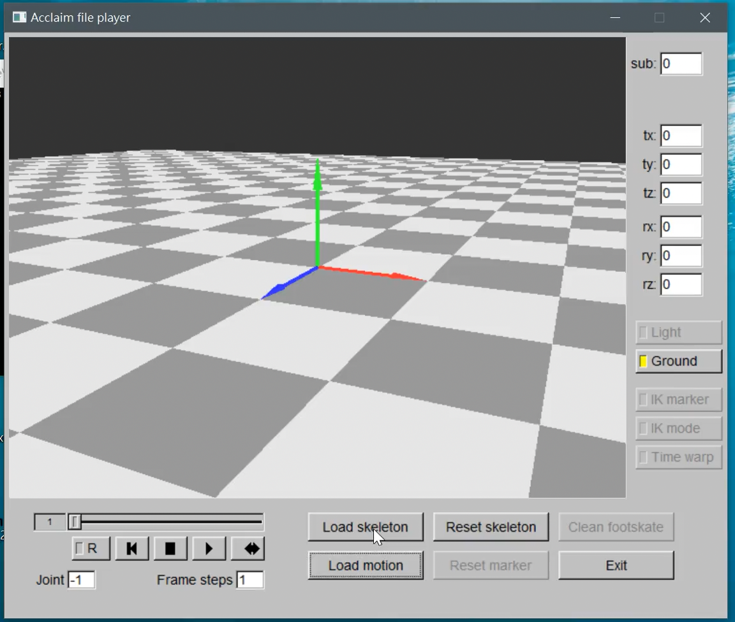

Slide 5
Time Warping
Modify the given motion sequences with arbitrary profile
Reference
keyframing.pptx, p.40-p.50
acclaim_FK_IKnote.pdf, section “Motion interpolation”, on p.7

Slide 6
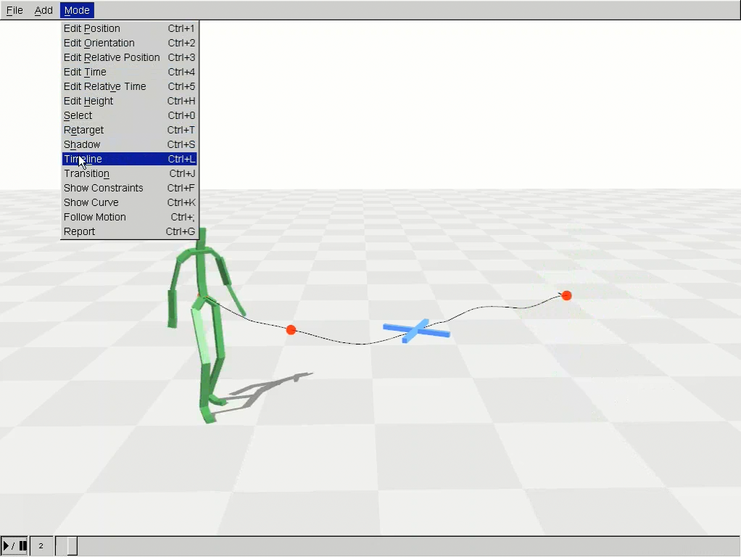

Slide 7
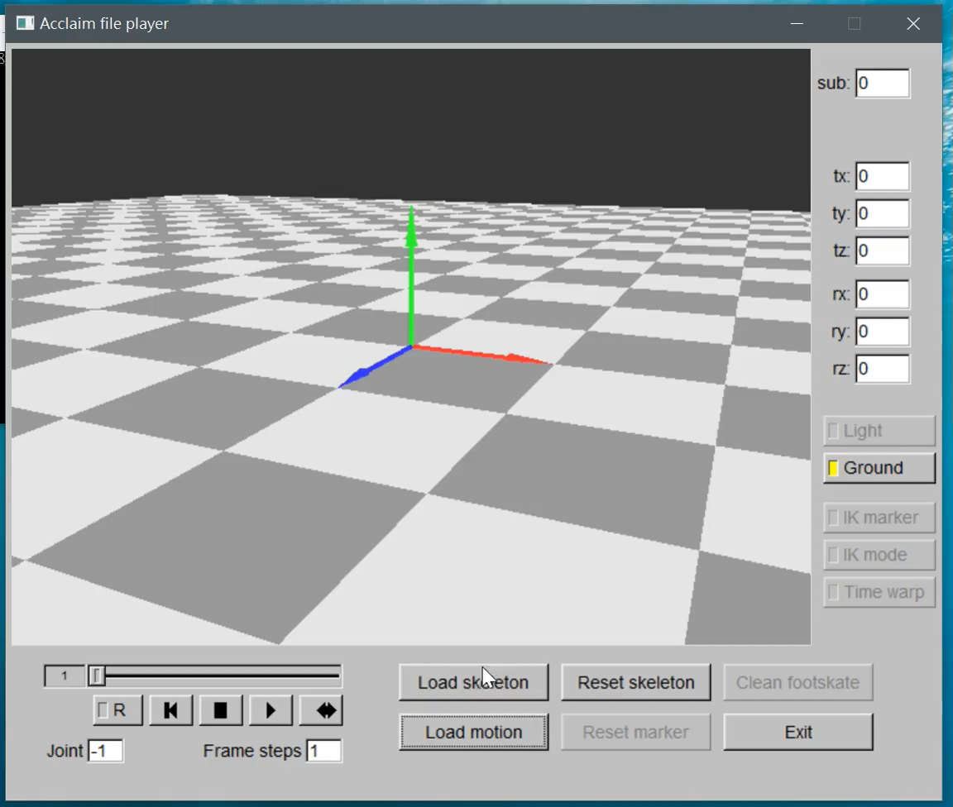

Slide 8
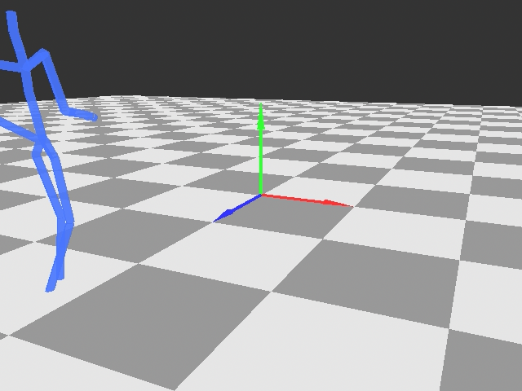

Slide 9
Environment
Windows 10
Microsoft Visual Studio Professional 2013
Third party
fltk: gui
Eigen: matrix operations
boost: useful utilities beyond STL

Slide 10
gui Module
gui::MainWindow
Specify the UI window
Handle all UI flows
gui::Display
Handle almost all events from MainWindow
Draw skeletons

Slide 11
gui::MainWindow
LoadSkeletonSlot
slot function to the button Load skeleton
LoadMotionSlot
slot function to the button Load motion
TimeWarpSlot
slot function to the button Time warp

Slide 12
gui::Display
Contain loaded skeletons & motions
Access asf & amc data by integer index
skeleton_coll_->at(i) the i-th loaded asf file
motion_coll_->at(i) the i-th loaded amc file
fk_solver_coll_->at(i) the forward kinematics for the i-th skeleton & motion

Slide 13
math Module
Contain all necessary vector and matrix operation
Implemented with Eigen
a C++ template library for linear algebra
Eigen website:
http://eigen.tuxfamily.org/index.php?title=Main_Page

Slide 14
math Module
math::Vector3d_t
column vector with x, y, and z components
math::RotMat3d_t
3D rotation matrix
math::HomoXfm3d_t
3D homogeneous transformation
math::Quaternion_t
3D quaternion with w, x, y, and z

Slide 15
math Module
math:: Vector6d_t
column vector containing 3D angular & linear vectors
represent the 6 degrees-of-freedom in the Cartesian space
only root joint has translations
math:: Vector6dColl_t
represent motion data of a single frame

Slide 16
math Module
math:: SpatialTemporalVector6d_t
2D storage of math::Vector6d_t
represent whole motion sequence of an amc file
temporal_size is the frame no. of the amc file
spatial_size is the body no. of the asf file

Slide 17
math utilities
math::ComputeRotMatXyz
compute rotation matrix from Euler angles by the order x-y-z
math::ComputeQuaternionXyz
compute quaternion from Euler angles by the order x-y-z
math::ComputeEulerAngleXyz
compute Euler angles from a rotation matrix by the order x-y-z

Slide 18
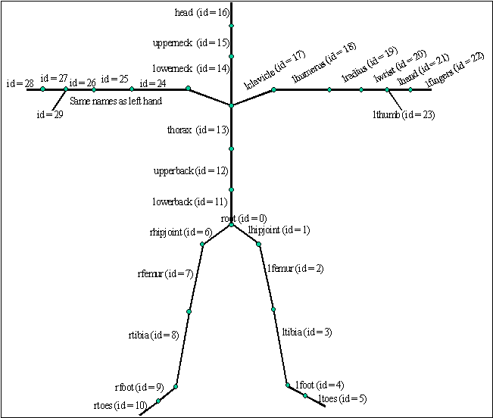
kinematics Module
kinematics::ArticIdx
represent the body index with its parent body index
used to construct paths to traverse the articulated system e.g., root -> lhipjoint -> lfemur -> ltibia -> lfoot

Slide 19
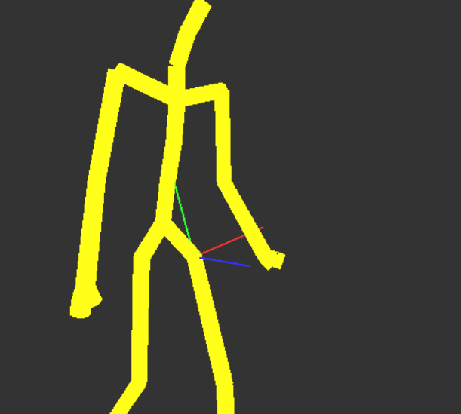
Pose example
Pose - example
Local coordinate
startPos
endPos

Slide 20
kinematics::Pose
Represent the bone’s translation & rotation
start_pos the proximal end
end_pos the distal end
rotation the rotation matrix
Show forward kinematics result by whole-body pose
apply gui::Renderer::DrawCylinder
root
lhipjoint
lfemur

Slide 21
acclaim Module
acclaim::Skeleton
data structure for the parsed asf file
acclaim::Motion
data structure for the parsed amc file

Slide 22
acclaim::Skeleton
bone_ptr
access the acclaim::Bone instance
Refer to “acclaim_FK_IKnote.pdf” for detailed definition of each variable
bone_num
bone no. of the skeleton instance

Slide 23
acclaim::Motion
joint_spatial_pos
access the motion data of the indicated frame
whole_sequence
access all motion data contained in the amc file

Slide 24
param Module
param::Config
parse the parameter setting in the .\parameter\config.xml

Slide 25
Forward Kinematics - What to Do
Load “running.amc” or “punch_kick.amc”
Implement kinematics::ForwardSolver
remove the instance helper::ForwardKinematics
ComputeSkeletonPose
input: motion data of a single frame (math::Vector6dColl_t)
output: whole body pose (kinematics::PoseColl_t)
Implement ComputeSkeletonPose Using Quaternion

Slide 26
Time Warping
kinematics::TimeWarpHardConstraint_t
frame_idx
play_second
Two sets of constraints
h: time step, n: frame no.
{0, 0.0}, {140, 150h},{n-1, (n-1)h}
{0, 0.0}, {160, 150h}, {n-1, (n-1)h}
access the constrained frame_idx via param_->value<int32_t>( "time_warp.desired_catch_frame_idx“ )

Slide 27
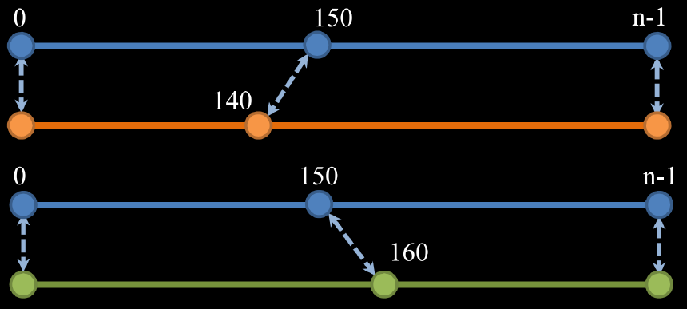
h: time step, n: frame no.
{0, 0.0}, {140, 150h},{n-1, (n-1)h}
{0, 0.0}, {160, 150h}, {n-1, (n-1)h}

Slide 28
Time Warping - What to Do
Load “punch_kick.amc”
Implement kinematics::TimeWarper
ComputeWarpedMotion
input: hard constraints
output: whole sequence of warped motion
Your character should catch the ball after warping
pass two sets of constraints listed on the previous page

Slide 29
Interpolation
Use Quaternion
Linear interpolation

Slide 30
Grading
Froward kinematics 60%
Using Quaternion
Time warping 30%
Using Quaternion
Report 10%
Bonus 10%

Slide 31
Bonus
remove the instance helper_fk_->ConstructArticPath(); and construct it by yourself
Implement FK by other Representing 3D rotations
Notice : Mention it in your report

Slide 32
Suggested Outline of Report
Introduction/Motivation
Fundamentals
describe local & global coordinate in your words
Implementation
Result & Discussion
Conclusion

Slide 33
Submission
Compress all materials into a zip file
ensure your solution could be built successfully
naming rule: CA2_ID_Version e.g., CA2_1234567_v01.zip
Your zip file shall contain
source code (without boost & Eigen)
report in pdf or MS word format, no more than 10 pages
Update to E3
no limit to the no. of times you can upload
the latest version is your final submission

Slide 34
Due Date
2018/05/16 , 23:59

Slide 35
Late and Cheating
Late policies
Penalty of 10 points of the value of the assignment/day
Cheating policies
0 points for any cheating on assignments
Allowing another student to examine your code is also considered as cheating

Slide 36
You can find TA in…
Email:
liou8308@gmail.com
Lab EC229B
Need appointment
Please briefly mention your question when you contact me

